Slide 1

01
SERVO MOTOR WITH MOTOR DRIVER
CSE 315
Peripherals & Interfacing
Durjoy Mistry
UAP CSE,
Year 3 | Semester 2

Slide 2
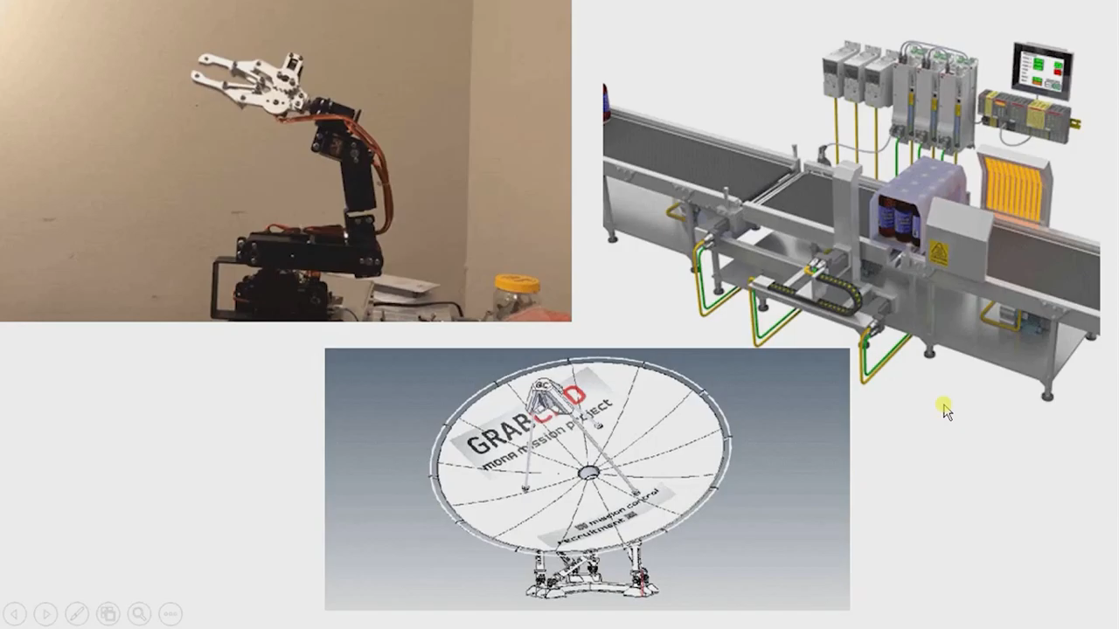
Have you ever wondered?
02
Servo motor with motor driver

Slide 3

03
Agenda
Servo Motor Basics
Servo Motor Basics(Visuals)
How does it work?
Types
Types Explanation
Working Principles of a DC Servo Motor
Working Principles of an AC Servo Motor
Driving Servo Motors with L293D Shield
Driving Servo Motors with L293D (Video)
Code
Code Explanation
Servo Motor Applications

Slide 4
Servo Motor Basics
04
Servo motors are part of a closed-loop system and are comprised of several parts namely :
Control circuit
Servo motor
Shaft
Amplifier
Encoder or resolver.
Servo motor with motor driver

Slide 5
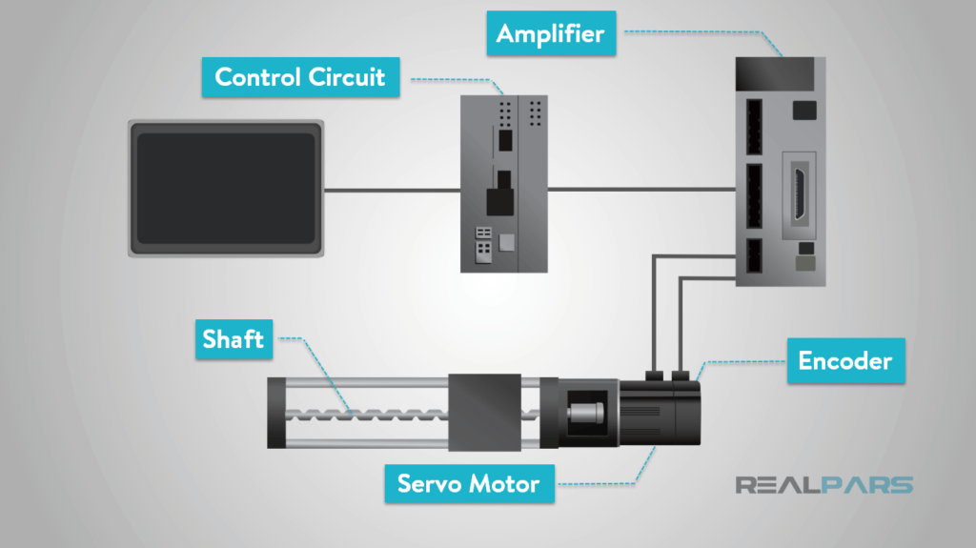
Servo Motor Basics(Visuals)
05

Slide 6
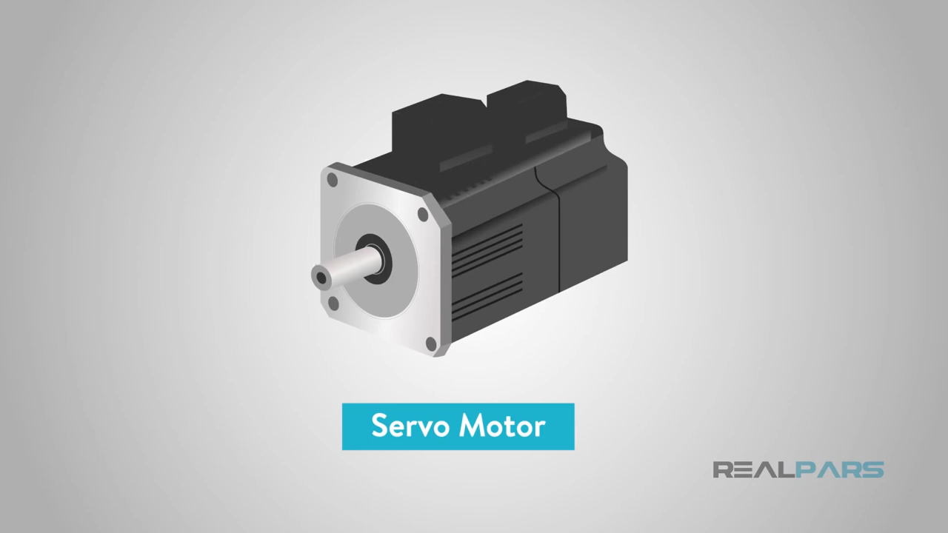
How Does it work?(Video)
06
Servo motor with motor driver
SOURCE

Slide 7
Types(3 x 2)
07
AC or DC
Brush or Brushless(DC)
Synchronous or Asynchronous(AC)
Servo motor with motor driver

Slide 8
AC or DC
08
Point
AC
DC
speed is determined by the frequency of the applied voltage and the number of magnetic poles.
speed is directly proportional to the supply voltage with a constant load.
Performance
Servo motor with motor driver
AC motors will withstand higher current and are more commonly used where high repetitions and high precision are required.
DC motors are also used in servo systems but recommended when there's no demand of high precision.
Usablity

Slide 9
Brushed or Brushless(DC)
09
Point
Brushed
Brushless
Brushed motors are generally less expensive and simpler to operate
Brushless motors are comparatively more expensive and harder to operate
Cost & Usability
Servo motor with motor driver
more reliable
have higher efficiency
and are less noisy.
Less reliable,
have lower efficiency,
and are more noisy.
Performance

Slide 10
Synchronous or Asynchronous(AC)
10
Point
Synchronous
Asynchronous
Synchronous motor is costlier compared to asynchronous motors.
Asynchronous motor is cheaper compared to synchronous motors.
Cost
Servo motor with motor driver
Speed
Stator speed is equal to the speed of totor
Stator speed is not equal to the speed of rotor. Rotor is slower than stator.

Slide 11
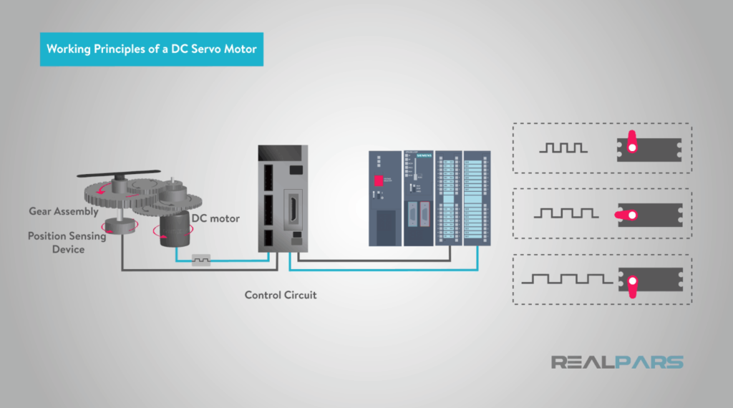
Working Principles of a DC Servo Motor(1)
11
Servo motor with motor driver

Slide 12
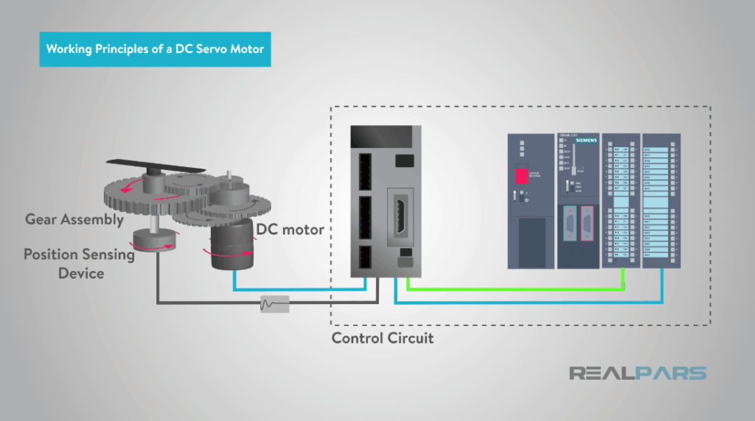
Working Principles of a DC Servo Motor(2)
12
Servo motor with motor driver
SOURCE

Slide 13

Working Principles of a DC Servo Motor(Video)
13
Servo motor with motor driver
SOURCE

Slide 14
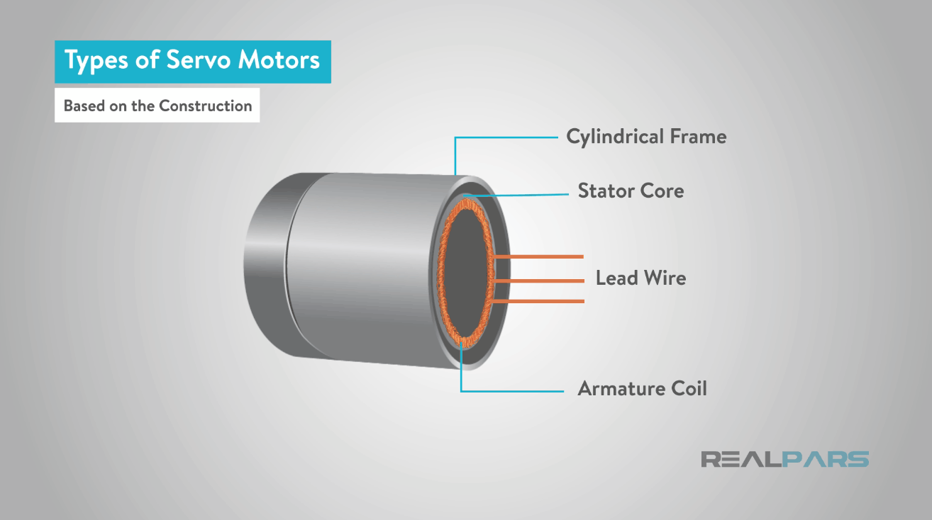
Working Principles of a AC Servo Motor(1)
14
Servo motor with motor driver
SOURCE

Slide 15
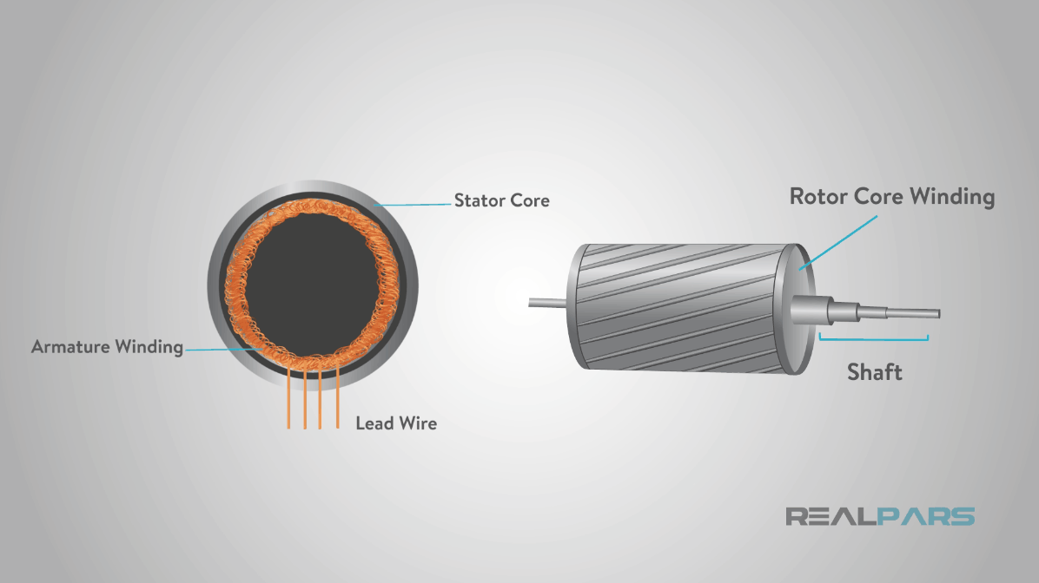
Working Principles of a AC Servo Motor(2)
15
Servo motor with motor driver
SOURCE

Slide 16
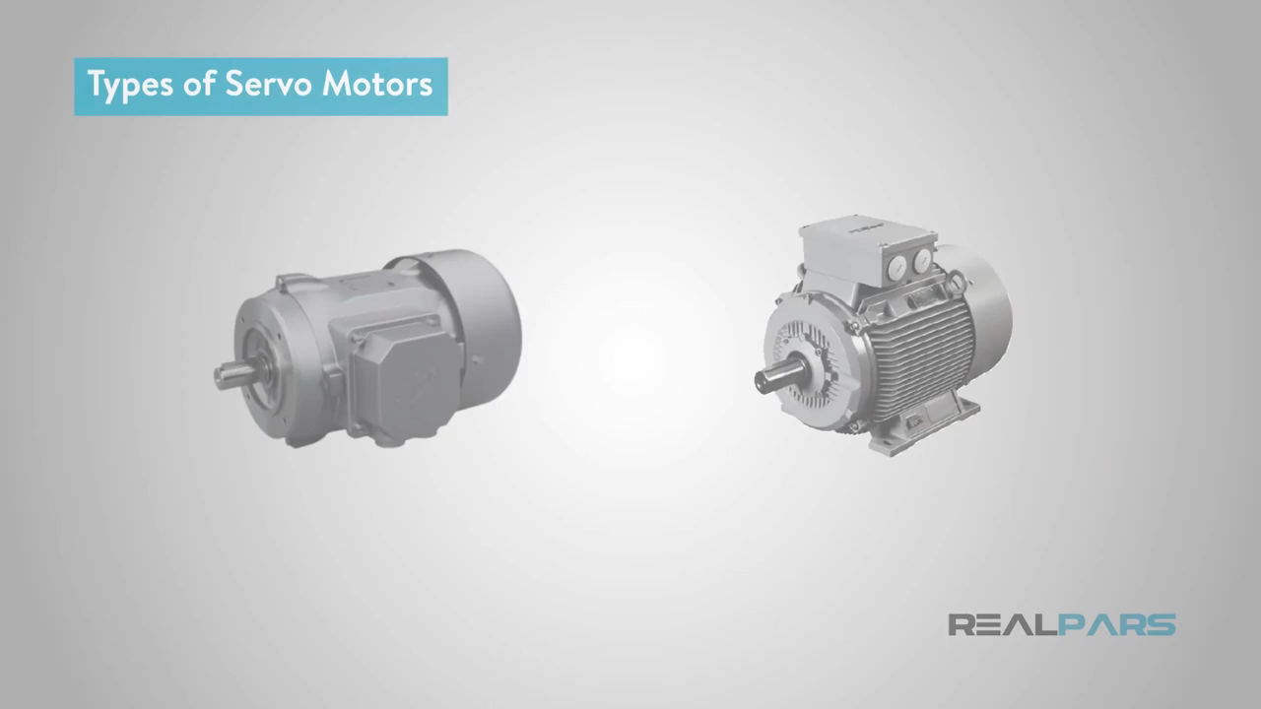
Working Principles of a AC Servo Motor(Video)- Synchronous
16
Servo motor with motor driver
SOURCE

Slide 17
Working Principles of a AC Servo Motor(Video)-Asynchronous
17
Servo motor with motor driver
SOURCE

Slide 18
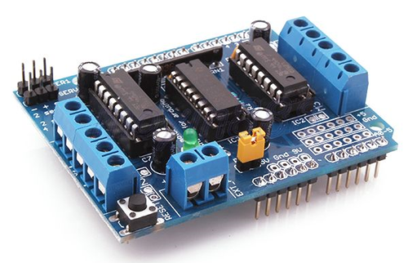
L293D Motor Driver
18
Servo Terminal
Stepper #2
Reset
External Power
Supply Terminal
Power
Supply Terminal

Slide 19
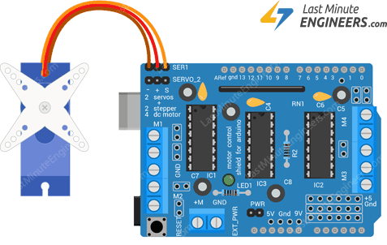
Driving Servo Motors with L293D Shield
19
Ground, VCC, Signal
Orange: Signal
Red: VCC
Last: Ground

Slide 20
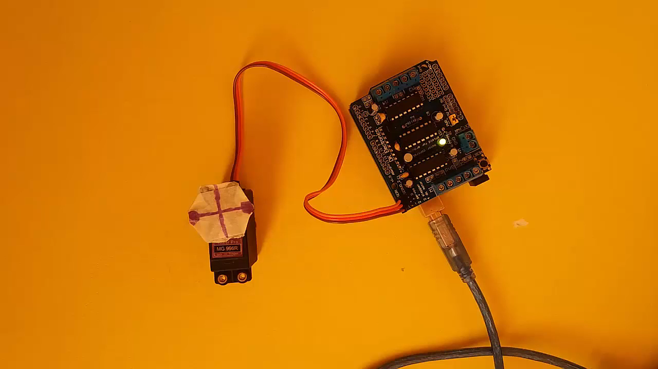


Driving Servo Motors with L293D (Video)
20
See
Codes
PLAY THIS ON

Slide 21
Code + Explanation
21
When the program starts running, the servo motor will rotate slowly from 0 degrees to 180 degrees, one degree at a time. When the motor has rotated 180 degrees, it will begin to rotate in the other direction until it returns to the home position.
#include <Servo.h> //Servo library
Servo servo_test; //initialize a servo object for the connected servo
int angle = 0;
void setup()
{
servo_test.attach(9); // attach the signal pin of servo to pin9 of arduino
}
Servo motor with motor driver

Slide 22
Code + Explanation
22
void loop()
{
for(angle = 0; angle < 180; angle += 1) // command to move from 0 degrees to 180 degrees
{
servo_test.write(angle); //command to rotate the servo to the specified angle
delay(15);
}
delay(1000);
for(angle = 180; angle>=1; angle-=5) // command to move from 180 degrees to 0 degrees
{
servo_test.write(angle); //command to rotate the servo to the specified angle
delay(5);
}
delay(1000);
}
Servo motor with motor driver

Slide 23
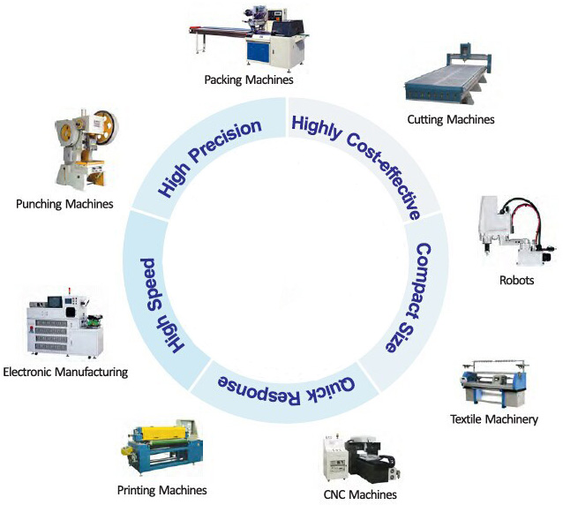
Servo Motor Applications
23
Servo motor with motor driver

Slide 24

24
Thank you!
LET US KNOW IF YOU HAVE QUESTIONS OR CLARIFICATIONS.
Servo motor with motor driver

Slide 25
Reference
25
slide 3-17 (Servo Motor Basics, Type, Working Principles):
https://realpars.com/servo-motor/
Slide 18-19 (L293D Motor Driver):
https://lastminuteengineers.com/l293d-motor-driver-shield-arduino-tutorial/
Slide 20 (Connect with Arduino):
https://youtu.be/zZ1sYtoo5gw
Slide 21-22 (Code):
https://www.allaboutcircuits.com/projects/servo-motor-control-with-an-arduino/
Servo motor with motor driver

